Slide 1
SCORE SC Lowcountry Overview
For The Life of Your Business
Mike Waters, SCORE SC Lowcountry Chapter Vice Chair Peter Veneto, SCORE SC Lowcountry Chapter Vice Chair Rod Casavant, SCORE SC Lowcountry Chapter Chair
September 7 2021

Slide 2
How We Serve: Our Clients
The SCORE SC Lowcountry Chapter assists small business and non-profit clients in:
Beaufort County
Colleton County
Jasper County
Hampton County
We support all business stages (startup to exit) and have outreach programs for:
Minorities
Women
Veterans
3

Slide 3
How We Serve: Mentoring, Education & Tools
Free and confidential
One-to-one Mentoring
Workshops, Webinars, Roundtables
Timely response to requests
Tailored to the Client situation
For business startups or taking a business to the next level
Comprehensive suite of topics
Articles, Tools and Templates
Sample Workshops
Comprehensive—build a business plan, financials, competitors, market analysis
Hundreds of online resources (in English & Spanish)
Leveraging Social Media
Focus on the Customer
Veteran Entrepreneurship
Simple Steps for Starting Your Business

Slide 4
How We Serve: Business Mentoring
Our clients’ success is our success. Our Chapter’s Business Mentors are trained and certified, have deep experience and are backed by a national team of SCORE volunteers available to assist.
FAST FACTS
Entrepreneurs who work with a mentor are 5X more likely to start a business.
Small business owners who have 3+ hours of mentoring report higher revenue.
We provide entrepreneurs and non-profits with free and local:
Personal, confidential, individual attention
Access to expertise that is right for their situation
From business experts with a variety of backgrounds, including corporate executives and current/former business owners who understand the local market
Mentors schedule socially distant meetings through Zoom, phone or in-person.

Slide 5
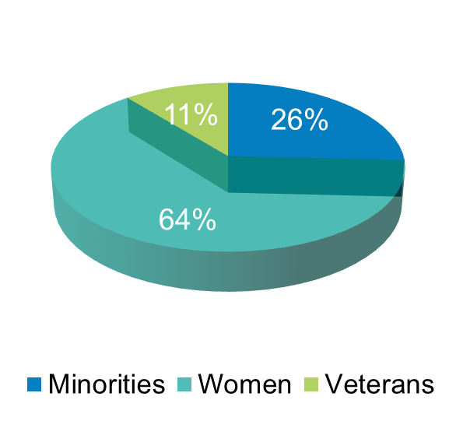
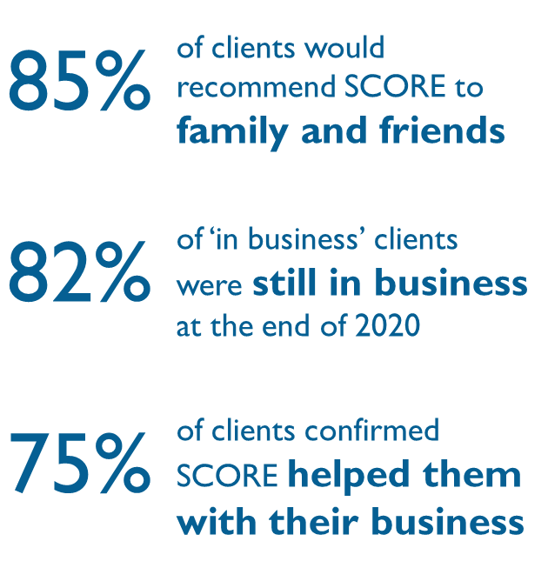
2020 By the Numbers
Client Mix
Community Impact
Value to Small Businesses
41 | New Businesses Started
130 | Total Jobs Created
2,353 | Total Chapter Services*

Slide 6
Award Winning Support
Recent Awards
Platinum Chapter for the past 4 years (2020) (top performance across the USA for a SCORE Chapter)
National SCORE Chapter of the Year–Small Markets (2019)
#1 National Rating for Client Engagement Results (2019)
SC District Chapter of the Year (2019 & 2018)
Annual Volunteer Award for Workplace/Agency from SoLoSCAVA Southern Lowcountry South Carolina Association of Volunteers

Slide 7
Key Collaborations for Minority Programs
Minority small businesses are underrepresented nationally. SCORE SC Lowcountry is aligning with other organizations to build on their successes with their programs.
SCORE SC Lowcountry and the South Carolina Commission on Minority Affairs have signed an MOU to partner and collaborate in promoting and assisting South Carolina’s small minority business owners.
We collaborate with the Native Island Business & Community Affairs Association, a Gullah and minority based organization in the Lowcountry, to provide business education to its members.
continued…

Slide 8
Key Collaboration for Minority Programs (continued)
Our partnership with the Beaufort County Black Chamber of Commerce is an example of how we support their program in place rather than reinvent something similar.
Since 2012, SCORE SC Lowcountry has partnered with the Beaufort County Black Chamber of Commerce who is a financial intermediary for SBA loans:
All applicants for their microloan program (up to $100,000) must attend SCORE provided three-day workshops which are offered a minimum of four (4) times annually.
Our workshops, covering how to start a business, marketing and basic finance, serve to prequalify candidates for these loans.

Slide 9
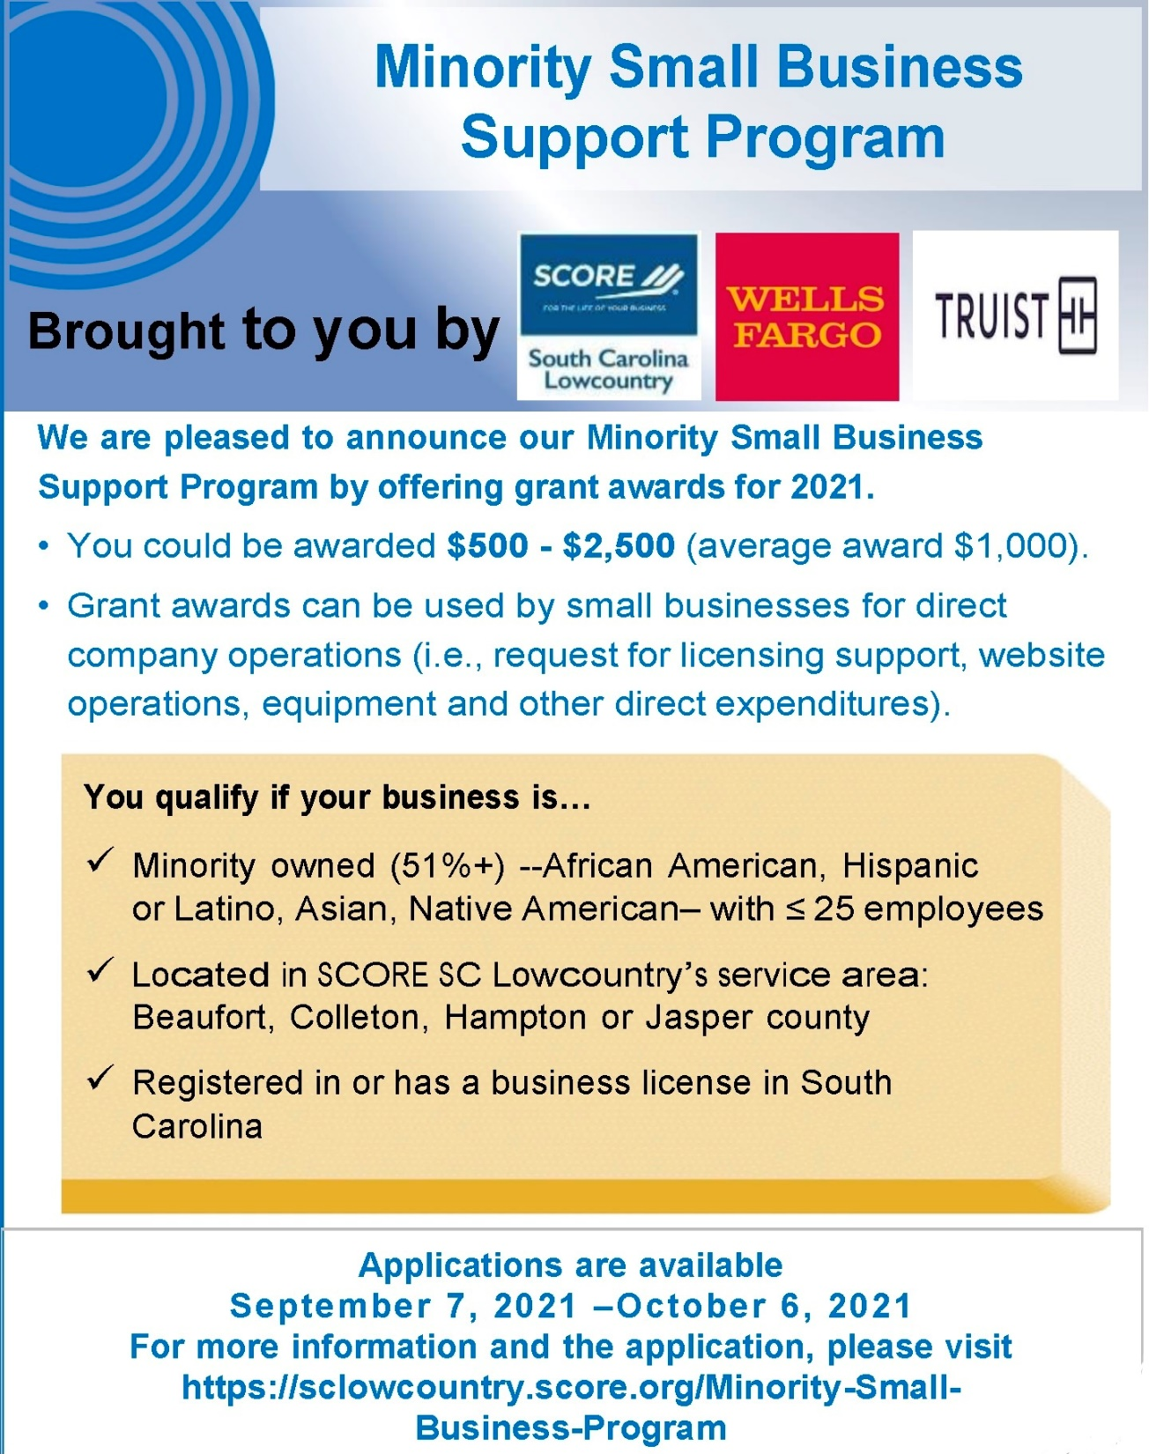

Slide 10
Thank you for your time today. We are happy questions at score-grants-0650@scorevolunteer.org .

